Slide 1

S D HERITAGE PRIDE SCHOOL
INTEGRATED CURRICULUM GUIDE
ACADEMIC PLANNER: 2025-26
Class : I
Education is the key that unlocks the door to endless possibilities, turning aspirations into accomplishments and curiosity into wisdom. It empowers students to shape their future and create a meaningful impact in the world.

Slide 2

ACADEMIC ITINERARY
CONTENT | PAGE NO.
OBJECTIVE & ENRICHMENTS | 1-2
EVALUATION SYSTEM | 3
INQUISITIES | 4
TEXTBOOK RECOMMENDATION | 5
TERM I SYLLABUS
ENGLISH | 6-7
HINDI | 7-8
MATHS | 8
ENVIRONMENTAL STUDIES | 8-9
GENERAL KNOWLEDGE & REASONING | 9
ICT | 10
ART & CRAFT | 11
TERM II SYLLABUS
ENGLISH | 12
HINDI | 13
MATHS | 14
ENVIRONMENTAL STUDIES | 14
GENERAL KNOWLEDGE & REASONING | 15
ICT | 15
ART & CRAFT | 16
TIME TABLE | 17
ACADEMIC CALENDAR | 18-19
CO SCHOLASTIC ACTIVITIES | 20
HOLIDAY CALENDAR | 21

Slide 3
OBJECTIVE & ENRICHMENTS
The given academic planner is a school docket designed to help students stay organized, track projects, and exams, follow class schedules, meet deadlines, take notes & more. It increases the students’ accountability to the commitment planned as well as provides them with a structure that contributes to their success.
Notebooks Assessment: Handwriting and Notebooks maintenance reflects one's working habits and personality. Therefore, Subject wise notebooks assessment is carried out by subject teachers in each term and weightage is added to the terminal result. The various parameters for the evaluation include handwriting, index, work completion, work submission, follow up of remarks given and maintenance of notebooks.
Inspections: In order to inculcate good working habits among the students regular inspections are carried out by the school which include uniforms, bags, notebooks.
ASL(Assessment of Speaking and Listening): To enhance Linguistic skills among the students, assessment of speaking and listening skills is carried out by the subject teachers in each term in the form of quiz, extempore, debates, discussions, storytelling and presentation.
Teaching Methodologies For Practical Learning: To develop skills, knowledge and understanding level of the learners , school uses the different teaching methodologies in order to improve practical learning of all the students. Teachers use demonstration, role – play, field trips, group discussions, audio - visual aids etc. for the better outcome.
Olympiads: For Better academic exposure, students are given the opportunity to showcase their talent through various competitive exams like Olympiads.
.
1

Slide 4
Student Council & Investiture Ceremony: The Student Council
helps share ideas, interests & concern with teachers & school principal. Realizing better sense of duty and honour and to develop leadership qualities. Students are encouraged to be the part of it and allocated with the duties in investiture ceremony. Students are selected for junior and senior cabinet depending upon their calibre and other qualities to take care of the discipline and other academic possibilities.
Activity Oriented Curriculum:
Scholastic and Co- Scholastic Activities: To supplement the academic curriculum and help in learning by doing school conducts co-curricular activities along with scholastic on regular basis in order to develop problem solving , reasoning and other collaborative abilities.
Inter-School Activities: To teach team work and to enhance social and emotional learning, SDHPS gives opportunity to the students to participate in various inter-school activities. Through these activities students get a platform to showcase their hidden strength and skills.
3. Spatial Perception Skills (SPS): Spatial Skills are high order skills such as problem solving, creative thinking & reasoning which support the students to perform well academically and in day-to-day life as well.
4. Subject Enrichment Activities:To enhance students’ understanding and application of concepts beyond the regular curriculum, Subject Enrichment Activities are conducted as an integral part of the academic program. These activities focus on skill development and practical learning, ensuring a deeper grasp of subject-specific knowledge.
Objectives of Subject Enrichment Activities
Reinforce classroom learning through hands-on experiences
Foster creativity, critical thinking, and problem-solving skills
Enhance linguistic, mathematical, scientific, and artistic abilities
Encourage interactive and experiential learning
2

Slide 5

EVALUATION CRITERIA
Evaluation System is devised to develop the habit of regular and systematic working amongst the students. Objective Type / Applications based / short answer questions get due weightage in the question papers to make the assessment more reliable and comprehensive.
In this regard besides various modes of continuous evaluation, Periodic Assessments and Terminal Assessments are conducted as per the given probable schedule for students.
TERM-1 |  | Periodic Assessment I | Notebook Assessment | Subject Enrichment | Terminal Assessment | Total
 | Maximum Marks | 20 | 5 | 5 | 70 | 100
 | Tentative Dates | July | September | September | September
 |  | 2nd Week | 1st Week | 1st Week | 3rd Week
TERM-2 |  | Periodic Assessment II | Notebook Assessment | Subject Enrichment | Terminal Assessment | Total
 | Maximum Marks | 20 | 5 | 5 | 70 | 100
 | Tentative Dates | December 2nd Week | February 1st Week | February 1st Week | February 4th Week
Final Weightage |  | Average of T1 + T2 |  |  |  | 100
3

Slide 6
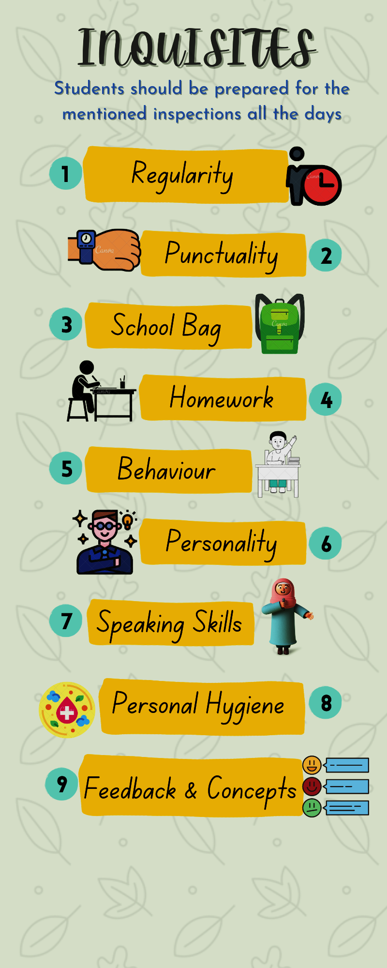
4

Slide 7
SCHOOL RECOMMENDED BOOKS
CLASS- II
Sr. No. | SUBJECT | BOOKS
1 | ENGLISH | MY GREEN BOOK OF ENGLISH (English Press)
2 |  | GOOD WITH GRAMMAR (Neuberg)
3 | HINDI | भाषा सेतु (प्राची पब्लिकेशन )
4
 |  | सार्थक हिंदी व्याकरण
5 | MATHEMATICS | MATHEMATICS FOUNDATIONAL STAGE (Amaira)
6 | EVS | MY GREEN WORLD (Millenium’s)
7 | GENERAL KNOWLEDGE | GENERAL KNOWLEDGE (Future Kids)
8 | REASONING | REASONING APPTITUDE WITH G.K
9 | COMPUTER | CYBER KIDS
10 | DRAWING | WINGS OF ART
5

Slide 8
FIRST TERM
MONTH/ SUBJECT | ENGLISH
NOTE | For Enhancing Reading And Writing Skill: Word Meaning, Dictation Of Difficult Words, Sentence Formation, Question- Answers, Book Exercise And Complete The Lines Of The Poem Will Be Taken.
APRIL | Recapitulation:-Sounds a,e,i,o,u,ay,ee,ai, oo,ou,oi,ll,ch, sh, th, ing Art Integration:- Word Picture Collage-Draw & Colour The Pictures of Different Sound Words. Presentation:- Ice-Breaking Session. Experiential Learning:- Fun Game- Hopscotch of Letters
MAY | Literature:- L-1 Me And My Brother Grammar:- L-1 Naming Words Writing Skills:- All About Me, My Pet – Dog Art Integration:- Naming Words Garden-Draw a garden/class room with different things you see there. Presentation:- Students Will Speak Few Lines About Their Family. Experiential Learning:- Noun Charade
JULY | Literature- L-2 A Trip to Grandma’s House Poem- L-3 Our Classroom Grammar- L-2 Special Names, L-3 A or An ? Writing Skills- My Self, My Favorite Fruit / vegetable, My Birthday Party Art Integration:- Generations of Greatness- Make a collage of character traits of your Grandfather/Grandmother. Presentation:- Show & Tell Activity on My Favorite Fruit Experiential Learning: Noun Scavenger Game
AUGUST | Literature- L-4 The Cat with no Tail Poem- L-5 The Swing Grammar- L-15 This, That, These, Those,L-4 One or Many ? Writing Skills- Rainy Day, My Riding Partner- My Bicycle Art Integration:- On The Wings of Imagination- Draw and colour a picture of your favourite pet.( with the help of numbers) Presentation:- Poem Recitation Competition Experiential Learning: Bingo Game - One and Many
SEPTEMBER | REVISION FOR FIRST TERM ASSESSMENT
6

Slide 9

महीना / विषय | हिंदी
नोट :- | सभी पाठों के कठिन शब्दों का श्रुतलेख, शब्दार्थ, प्रश्न-उत्तर, वाक्य रचना, कविता की पंक्तियाँ तथा पाठ के अभ्यास लिए जाएंगे I
अप्रैल | पाठ्यपुस्तक:- पाठ-1 वर्णमाला , पाठ -2 आओ पढ़ें वर्णों का जोड़, पाठ-3 आ की मात्रा , पाठ-4 इ की मात्रा, पाठ-5 ई की मात्रा, पाठ-6 सबीना की बकरी, पाठ-7 उ की मात्रा कला एकीकरण:- स्वर व्यंजन की जादुई टोपी - स्वर और व्यंजन की सहायता से शब्दों का निर्माण करवाया जाएगा ।
मई | पाठ्यपुस्तक:- पाठ -8 कुमुद की चुहिया, पाठ- 9 ऊ की मात्रा, पाठ -10 जूही का झूला, पाठ-11 ए की मात्रा, पाठ -12 मेला, पाठ -13 ऐ की मात्रा रचनात्मक लेखन- मेरी प्रिय दोस्त- मेरी माँ , मेरा प्रिय खिलौना कला एकीकरण- ममता का आँगन - मेरी माँ - अपनी माँ की तस्वीर का फ्रेम बनाओ I प्रस्तुतीकरण- अपने पिता से सम्बंधित कुछ पंक्तियाँ बोले I
जुलाई | पाठ्यपुस्तक:- पाठ -14 बैजनाथ आया, पाठ- 15 ओ, पाठ - 16 मोहन का घोडा, पाठ -17 औ, पाठ -18 रौनक की मौसी मौसा व्याकरण- पाठ- 1 भाषा , पाठ- 2 अक्षर ज्ञान, पाठ-10 अंक रचनात्मक लेखन- कक्षा का प्रथम दिन, मेरा विद्यालय कला एकीकरण- औ की मात्रा से सम्बंधित चित्र बनाकर रंग भरो I प्रस्तुतीकरण- मेरी यादें ग्रीष्मावकाश का अनुभव साझा करो I
अगस्त | पाठ्यपुस्तक:- पाठ -19 अं की मात्रा , पाठ- 20 सुंदर भारत, पाठ - 21 चन्द्रबिन्दु, पाठ - 22 गाँव का ऊँट, पाठ -23 अ: व्याकरण- पाठ -11 फल सब्ज़ी, पाठ- 3 मात्रा ज्ञान , पाठ - 4 संज्ञा रचनात्मक लेखन- स्वतंत्रता दिवस , रिश्तों का अनोखा बंधन - रक्षा बंधन कला एकीकरण-संज्ञा का पेड़ - संज्ञा को श्रेणियों मे बाटें । प्रस्तुतीकरण- रक्षा बंधन की कविता का प्रस्तुतीकरण I
सितम्बर | अर्द्धवार्षिक परीक्षा के लिए दोहराई
7

Slide 10
MONTH/ SUBJECT | MATHS
APRIL | Revision of counting 1 to 200, Tables 2 to 5, Numbers in words and figures 1 to 50. Unit 1:Comparison, Unit 2: Numbers up to 9 Art Integration:- Make train of tables. Experiential Learning: Fun With Cards- Revision of numbers.
MAY | Unit 3: Addition up to 9, Unit 5: Numbers from 10 to 20 Counting 201 to 300, Tables 6 and 7, Numbers in words and figures 51 to 70. Experiential Learning: Addition Bingo Game
JULY | Unit 4: Subtraction up to 9, Unit 6: Number From 21 to 100 Unit 9: Shapes ( Circle, Square), Counting 301 to 400, Tables 8 Numbers in words and figures 71 to 90. Experiential Learning: Presentation:- Let’s Play Hopscotch with Numbers.
AUGUST | Unit 7: Addition and Subtraction, Unit 9: Shapes (Triangle, Rectangle) Counting 401 to 500, Table of 9 Numbers in words and figures 91 to 100. Art Integration: Shapes Collage
SEPTEMBER | REVISION FOR FIRST TERM ASSESSMENT
MONTH/ SUBJECT | E.V.S.
APRIL | Ch-1 About Me, Art Integration:- Make a spin wheel prop talking about yourself Audio Visual Session- My Body
MAY | Ch-2 My body, Ch-3 My Sense Organs Art Integration:- Draw/Paste pictures of products that you use to keep your body clean. Experiential Learning: Touch and Feel
JULY | Ch- 4 My Family and Friends ,Ch- 5 My House and School, Art Integration:- create a giant welcome sign for your home. Experiential Learning: Role Play On- my Family Audio Visual Session- Social Life
8

Slide 11
AUGUST | Ch-6 My Food Habits, Ch-8 Good Manners Ch-11 Our Nation Art Integration:-Make a ‘Thank you’ card for your friend . Experiential Learning: Eat Healthy Stay Strong-Fancy Dress Parade Audio Visual Session- Our Nation-My Country: My Pride
SEPTEMBER | REVISION FOR FIRST TERM ASSESSMENT
MONTH/ SUBJECT | GENERAL KNOWLEDGE & REASONING
APRIL | L-1 Fruit Plate, L-2 I am Hungry, L-3 Jungle Friends , L- 4 Flower Bower , L-5 Birdies GK Hunt 1: My Home Reasoning:Ch-1 Matching
MAY | L-6 Mother and Young Ones, L-7 Little Insects, L-8 Seed to Plant, L-9 A New House, L-10 Means to Transport GK Hunt 2: My Classroom Reasoning: Ch-2 Sorting
JULY | L-11 Thank you, Helpers, L-12 Marvel of Monuments, L-13 Look k Around, L-14 My Pride , L-15 Monuments in Delhi, L-16 Festival Food GK Hunt 3: Sports Mix Up, Reasoning: Ch-4 Ordering
AUGUST | L-17 I Like to Eat , L-18 Indian Stars, L-19 Vocab Tab , L-20 Story Nory , L-21 Sing Poems, L-22 Opposites, L-23 What’s the Word ? Test Paper 1 GK Hunt 8: Our National Symbol, Reasoning:Ch-6 Shadows
SEPTEMBER | REVISION FOR FIRST TERM ASSESSMENT
9

Slide 12
MONTH/ SUBJECT | ICT
APRIL | Ch-1 Know your Computer Lab Activity: Fill colors in different pictures using fill color tool in Tux Paint. Programming : Introduction to Tux Paint
MAY | Ch-2 Computer – A Wonderful Machine Lab Activity: Draw different objects using Shape Group in Tux Paint. Programming : Shape tool in Tux Paint
JULY | Ch-3 Computer is a Smart Machine Lab Activity: Make a beautiful ‘Garden’ in Tux Paint. Programming : Color tool in Tux Paint
AUGUST | Ch-4 Computers are Everywhere Lab Activity: Create a beautiful picture in Tux Paint by using stamp, brush and color tool. Programming : Stamp tool in Tux Paint
SEPTEMBER | REVISION FOR FIRST TERM ASSESSMENT
MONTH/ SUBJECT | DRAWING
APRIL | Topic- Front Page, Butterfly Book page no.- 3-5 Activity- Earth Day Activity
MAY | Topic- Summer Scene, Hut, Duck Book page no.- 6-8 Mother’s Day Activity
JULY | Topic- Mushroom, Snail Book page no.- 10,11, 14,15 Monsoon Activity-
AUGUST | Topic- Honey Bee, Peacock with hand print Book page no.- 13, 16, 25, 26 Rakhi Activity Janmashtami Activity
SEPTEMBER | REVISION FOR FIRST TERM ASSESSMENT
10

Slide 13
SECOND TERM
MONTH/ SUBJECT | ENGLISH
OCTOBER | Literature- L-6 Never Give Up, L-7 The Old Man’s Field Grammar- L-5 Describing Words , L-6 I, She, He, It, We, They, Recap-1, Vocabulary- L-1 Animals and Young ones, L-4 Opposites Writing Skills- Picnic – A Day at Park , My Favourite Cartoon Character. Art Integration: Unleash Your Imagination- Craft a slogan card on Never Give Up. Experiential Learning: Describe Your surrounding.
NOVEMBER | Literature- L-8 Poem- The Caterpillar, L-9 India Our Country Grammar- L-7 Am, Is, Are, L-8 Doing Words Vocabulary L-2 Rhyming Words, L-4 Opposite Words Writing Skills- Cleanliness- The Essence of Life, Tiny actions, Big Impact- Save Water, My School Bag Art Integration:- Make a collage of National Symbols of India Experiential Learning: Look Around and Build a sentence (Doing words)
DECEMBER | Literature- L-10 Say No to Plastic, L-11 Colours Grammar- L-9 Has and Have, L-10 What is happening, L-11 What happened earlier, L-13 Position Words Writing Skills- Mother Earth, Books- Treasure of Knowledge Art Integration:- Poster making (Say No to Plastic) Experiential Learning: Nature Walk
JANUARY | Literature- L-12 Raman, The Clever Grammar- L- 12 The Sentences, L-14 Joining Words Vocabulary L-3 Places in My School , Comprehension, Picture Composition Writing Skills- National Festival- Republic Day, Holi Experiential Learning: Story Hunt-Find few more stories about Tenali Raman and tell in the class.
SEPTEMBER | REVISION FOR FIRST TERM ASSESSMENT
12

Slide 14

महीना / विषय | हिंदी
अक्टूबर | पाठ्यपुस्तक:- पाठ - 24 ऋ की मात्रा , पाठ -25 संयुक्ताक्षर संयुक्त और दवित्व व्यंजन, पाठ - 1 प्रार्थना (कविता ), पाठ - 2 मेरा विद्यालय पाठ -3 मेरा मित्र व्याकरण- पाठ -5 लिंग, पाठ -6 वचन रचनात्मक लेखन- एक कदम स्वच्छता की ओर, रंग बिरंगी तितली कला एकीकरण- ऋ की मात्रा के चित्र बनाओ प्रायोगिक ज्ञान:- संयुक्ताक्षर, संयुक्त और दवित्व व्यंजन की शब्द अंताक्षरी
नवम्बर | पाठ्यपुस्तक:- पाठ - 4 सुनहरा हंस, पाठ -5 मीठा बोलो, पाठ- 6 हाथी और बन्दर व्याकरण- पाठ -7 सर्वनाम, पाठ - 8 विशेषण रचनात्मक लेखन- राष्ट्रीय पक्षी मोर, पुस्तकालय की सैर, मेरे दादाजी कला एकीकरण- पाठ- 6 का मंचन प्रायोगिक ज्ञान:-विशेषण का जादू - विशेषण शब्दों का वर्गीकरण
दिसम्बर | पाठ्यपुस्तक:- पाठ -7 आओ पतंग उड़ाऍं , पाठ - 8 चंदा मामा, पाठ -9 कार्टून से सीख व्याकरण- पाठ 9 क्रिया रचनात्मक लेखन- शिक्षा का महत्व, मेरा प्रिय खेल , चित्र वर्णन प्रायोगिक ज्ञान: चाँद के बारे में कुछ रोचक तथ्य बताओ | क्रिया की दुनिया - रेखा चित्र
जनवरी | पाठ्यपुस्तक:- पाठ - 10 पत्र की यात्रा, पाठ - 11 तिरंगा झंडा व्याकरण- गिनती 11-20, अपठित गद्यांश रचनात्मक लेखन- मेरा भारत महान, मेरे सपनों का घर, चित्र वर्णन प्रायोगिक ज्ञान:- अपने सपनों के घर का वर्णन करो I हमारा गौरव , हमारा तिरंगा- तिरंगे के रंगों के महत्व का प्रस्तुतीकरण कक्षा मे करवाया जाएगा।
फरवरी | वार्षिक परीक्षा के लिए दोहराई
13

Slide 15
MONTH/ SUBJECT | MATHS
OCTOBER | Unit -8 Multiplication, Unit -10 Pattern, Revision of Tables 2-9 Experiential Learning: SPIN THE WHEEL: Let’s learn addition and subtraction by spinning wheel.
NOVEMBER | Unit -11 Time, Unit -12 Money, Tables 10-12 Art Integration: Paste fake currency in your notebook Experiential Learning: Enactment of Let’s go for shoping with fake currency notes.
DECEMBER | Unit -13 Measurement, Unit -14 Ordinal Numbers Experiential Learning: Standard Measurement Activities
JANUARY | Unit -15 Data Handling, Worksheet and Mathematic Olympiad Experiential Learning: Counting and Sorting
FEBRUARY | REVISION FOR FINAL TERM ASSESSMENT
MONTH/ SUBJECT | E.V.S.
OCTOBER | Ch- 7 Keeping Healthy and Safe, Ch- 9 Places of Worship and Our Festivals Art Integration:- Paste pictures of healthy food Experiential Learning: Celebrating India:- Festival Adventure Audio Visual Session- Healthy Food Habits
NOVEMBER | Ch-10 People who help us ,Ch-12 Plants and Animals Around Us, Ch-13 Air and Water Art Integration:-Thankyou card for community helpers Presentation:- Show & Tell-Bring indoor plants and speak about their qualities. Audio Visual Session- Fauna and Flora
DECEMBER | Ch-14 Seasons of India, Ch-15 The Earth and the Sky Experiential Learning: find and speak some facts about Solar system. Art Integration: Seasonal Wheel craft- Paste / draw different types of seasons Audio Visual Session- Universe
14

Slide 16

JANUARY | Ch-16 How Do We Travel? , Ch- 17 Games We Play Sample Paper-2 Art Integration:- Draw or paste different means of transport. Audio Visual Session:- Demonstration on different types of transport.
FEBRUARY | REVISION FOR FINAL TERM ASSESSMENT
MONTH/ SUBJECT | GENERAL KNOWLEDGE & REASONING
OCTOBER | L-24 This is My Body, L-25 Happy Seasons, L-26 The Super Sky, L-27 Computer parts, L-28 Save Water GK Hunt 4: Right or Wrong Reasoning: Ch-3 Classification
NOVEMBER | L-29 Helpful Machines, L-30 A Balanced Meal , L-31 Circuits Workouts , L-32 Clean and Green Earth, L-33 Indoor Games GK Hunt 5: Mumma and Baby, Reasoning: Ch-5 Patterns
DECEMBER | L-34 Outdoor Fun, L-35 Park Play, L-36 Sports Stars, L-37 Colors Around Us, L-38 Things That Go Together GK Hunt 6: Water Animals Reasoning: Ch-7 Tiles
JANUARY | L- 39 Carnival Craze , L-40 Spot It, L-41 Being Crafty , L-42 Safe Kids, L-43 Mind Your Manners, Test Paper- 2 GK Hunt 7: Seasons Vocabulary Reasoning: Ch-8 Quantitative Quiz, Aptitude Test-2
FEBRUARY | REVISION FOR FINAL TERM ASSESSMENT
15

Slide 17
MONTH/ SUBJECT | ICT
OCTOBER | Ch:5 Parts of a Computer Lab Activity: In Tux Paint, type different words and change their styles using Text Tool. Programming : Text tool in Tux Paint
NOVEMBER | Ch:6 Knowing the keyboard Lab Activity: Draw your favorite picture and cover it with different effects using Magic Tool. Programming : Magic Tool in Tux Paint
DECEMBER | Ch:7 Knowing the Mouse Lab Activity: In wordpad, type few lines about ‘My School’. Programming : Introduction to wordpad
JANUARY | Ch:8 Let’s Paint Lab Activity: Make a beautiful house using different types of shapes and color it in Ms - Paint. Programming : MS - Paint
FEBRUARY | REVISION FOR FINAL TERM ASSESSMENT
MONTH/ SUBJECT | DRAWING
OCTOBER | Topic- Warli Art, Caterpillar Book page no.- 27-29 Dussehra Activity
NOVEMBER | Topic- Fish with Shapes, Figure with number Book page no.- 30, 33,34 Activity- Paper Craft
DECEMBER | Topic- Stippling Art, Snow Man Book page no.- 31, 35, 36, Christmas Activity
JANUARY | Topic- Boat in River, Flowers Book page no.- 39, 40 Republic Day Activity
16

Slide 18
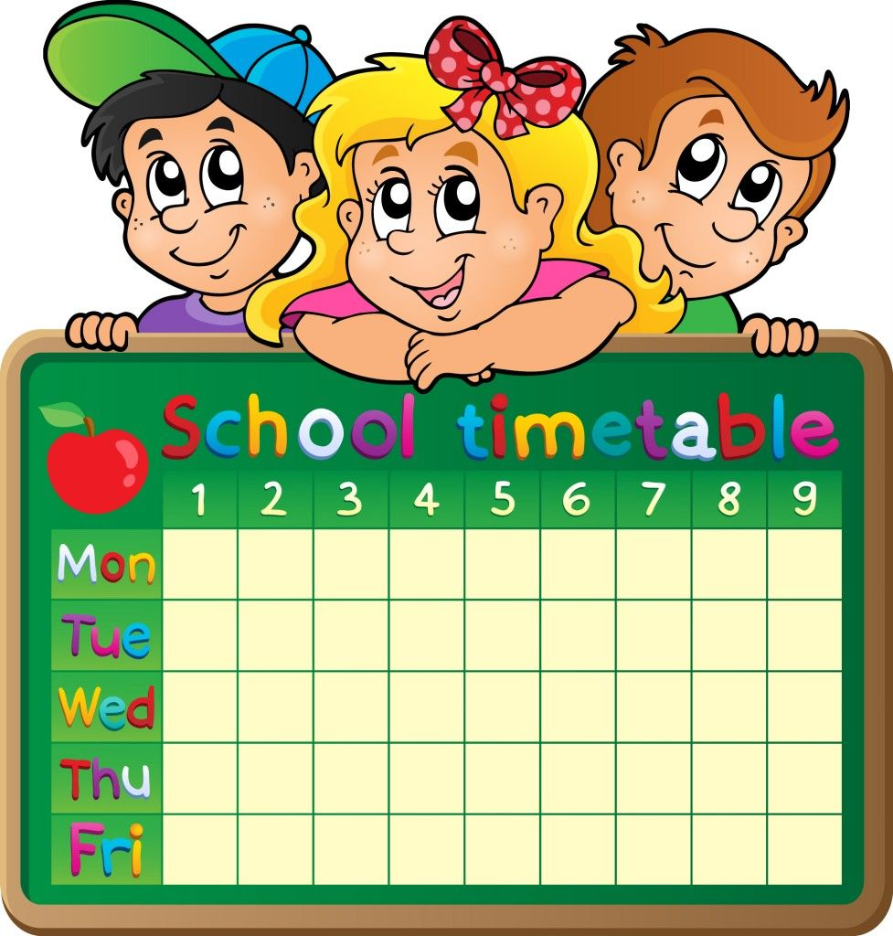



English Reader | First 20 days of the month
English Grammar | First 10 days of the month
Hindi Reader | First 20 days of the month
Hindi Grammar | First 10 days of the month
Maths | Monday to Saturday
E.V.S. | Monday to Thursday
G.K.,Reasoning & Composition book | Friday and Saturday
Notebooks
English | 2 Notebooks (Four lines)
Hindi | 2 Notebooks (Five lines)
Maths | 2 Notebooks (C.W + H.W.)
E.V.S. | 1 Notebooks (Four lines)
G.K. | 2 Notebooks (Four lines)
17

Slide 19
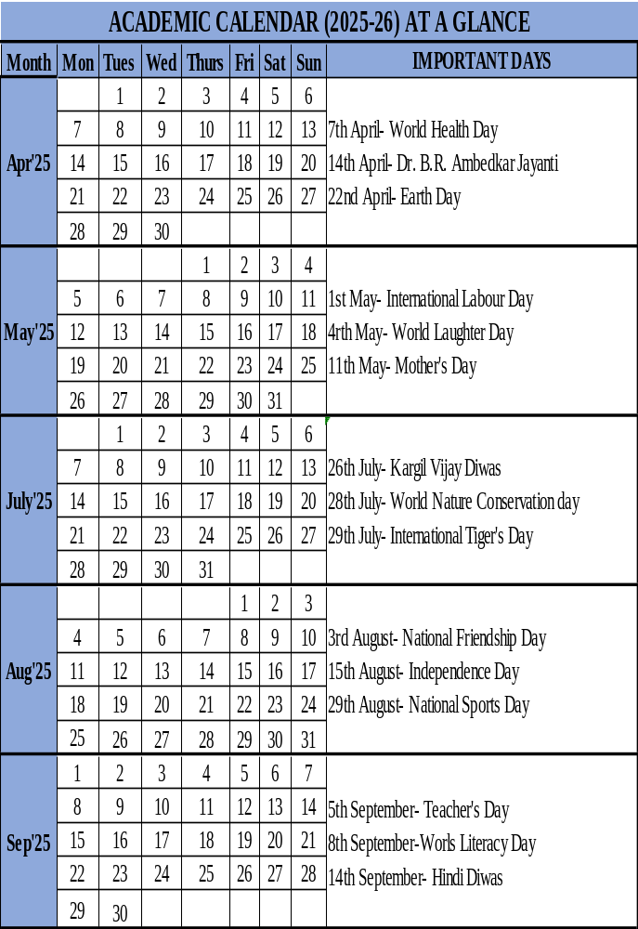
18

Slide 20
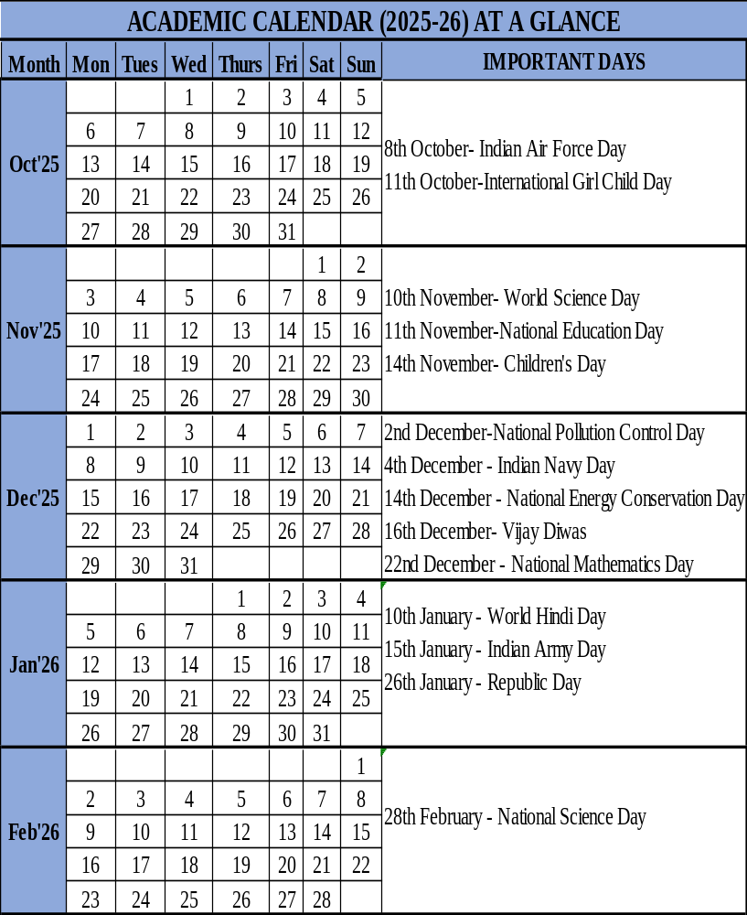

19

Slide 21
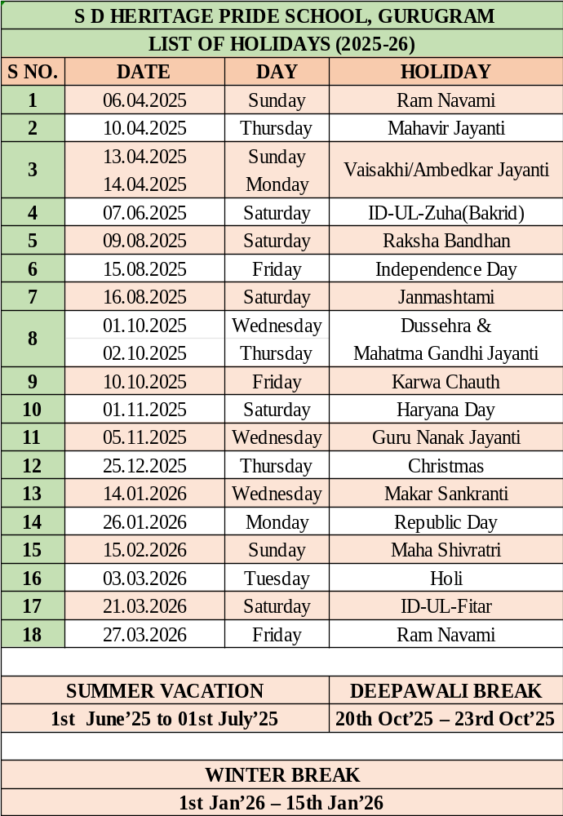
21

Slide 22

Education embraces the uniqueness of every child, nurturing their strengths, passions, and dreams. It shapes not just their minds but also their hearts, inspiring a lifelong love for learning and a meaningful purpose in life.

