Slide 1

S D HERITAGE PRIDE SCHOOL
INTEGRATED CURRICULUM GUIDE
ACADEMIC PLANNER: 2025-26
Class : II
"Education is the key that unlocks the door to endless possibilities, turning aspirations into accomplishments and curiosity into wisdom. It empowers students to shape their future and create a meaningful impact in the world."

Slide 2

ACADEMIC ITINERARY
CONTENT | PAGE NO.
OBJECTIVE & ENRICHMENTS | 1-2
EVALUATION SYSTEM | 3
INQUISITIES | 4
TEXTBOOK RECOMMENDATION | 5
TERM I SYLLABUS
ENGLISH | 6
HINDI | 7
MATHS | 8
ENVIRONMENTAL STUDIES | 8-9
GENERAL KNOWLEDGE & REASONING | 9
ICT | 10
ART & CRAFT | 11
TERM II SYLLABUS
ENGLISH | 12
HINDI | 13
MATHS | 14
ENVIRONMENTAL STUDIES | 14
GENERAL KNOWLEDGE & REASONING | 15
ICT | 15
ART & CRAFT | 16
TIME TABLE | 17
ACADEMIC CALENDAR | 18-19
CO SCHOLASTIC ACTIVITIES | 20
LIST OF HOLIDAYS | 21

Slide 3
OBJECTIVE & ENRICHMENTS
The given academic planner is a school docket designed to help students stay organized, track projects, and exams, follow class schedules, meet deadlines, take notes & more. It increases the students’ accountability to the commitment planned as well as provides them with a structure that contributes to their success.
Notebooks Assessment: Handwriting and Notebooks maintenance reflects one's working habits and personality. Therefore, Subject wise notebooks assessment is carried out by subject teachers in each term and weightage is added to the terminal result. The various parameters for the evaluation include handwriting, index, work completion, work submission, follow up of remarks given and maintenance of notebooks.
Inspections: In order to inculcate good working habits among the students regular inspections are carried out by the school which include uniforms, bags, notebooks.
ASL(Assessment of Speaking and Listening): To enhance Linguistic skills among the students, assessment of speaking and listening skills is carried out by the subject teachers in each term in the form of quiz, extempore, debates, discussions, storytelling and presentation.
Teaching Methodologies For Practical Learning: To develop skills, knowledge and understanding level of the learners , school uses the different teaching methodologies in order to improve practical learning of all the students. Teachers use demonstration, role – play, field trips, group discussions, audio - visual aids etc. for the better outcome.
Olympiads: For Better academic exposure, students are given the opportunity to showcase their talent through various competitive exams like Olympiads.
.
1

Slide 4
Student Council & Investiture Ceremony: The Student Council
helps share ideas, interests & concern with teachers & school principal. Realizing better sense of duty and honour and to develop leadership qualities. Students are encouraged to be the part of it and allocated with the duties in investiture ceremony. Students are selected for junior and senior cabinet depending upon their calibre and other qualities to take care of the discipline and other academic possibilities.
Activity Oriented Curriculum:
Scholastic and Co- Scholastic Activities: To supplement the academic curriculum and help in learning by doing school conducts co-curricular activities along with scholastic on regular basis in order to develop problem solving , reasoning and other collaborative abilities.
Inter-School Activities: To teach team work and to enhance social and emotional learning, SDHPS gives opportunity to the students to participate in various inter-school activities. Through these activities students get a platform to showcase their hidden strength and skills.
3. Spatial Perception Skills (SPS): Spatial Skills are high order skills such as problem solving, creative thinking & reasoning which support the students to perform well academically and in day-to-day life as well.
4. Subject Enrichment Activities:To enhance students’ understanding and application of concepts beyond the regular curriculum, Subject Enrichment Activities are conducted as an integral part of the academic program. These activities focus on skill development and practical learning, ensuring a deeper grasp of subject-specific knowledge.
Objectives of Subject Enrichment Activities
Reinforce classroom learning through hands-on experiences
Foster creativity, critical thinking, and problem-solving skills
Enhance linguistic, mathematical, scientific, and artistic abilities
Encourage interactive and experiential learning
2

Slide 5

EVALUATION CRITERIA
Evaluation System is devised to develop the habit of regular and systematic working amongst the students. Objective Type / Applications based / short answer questions get due weightage in the question papers to make the assessment more reliable and comprehensive.
In this regard besides various modes of continuous evaluation, periodic assessments and terminal assessents are conducted as per the given probable schedule for students.
TERM-1 |  | Periodic Assessment I | Notebook Assessment | Subject Enrichment | Terminal Assessment | Total
 | Maximum Marks | 20 | 5 | 5 | 70 | 100
 | Tentative Dates | July | September | September | September
 |  | 2nd Week | 1st Week | 1st Week | 3rd Week
TERM-2 |  | Periodic Assessment II | Notebook Assessment | Subject Enrichment | Terminal Assessment | Total
 | Maximum Marks | 20 | 5 | 5 | 70 | 100
 | Tentative Dates | December 2nd Week | February 1st Week | February 1st Week | February 4th Week
Final Weightage |  | Average of T1 + T2 |  |  |  | 100
3

Slide 6
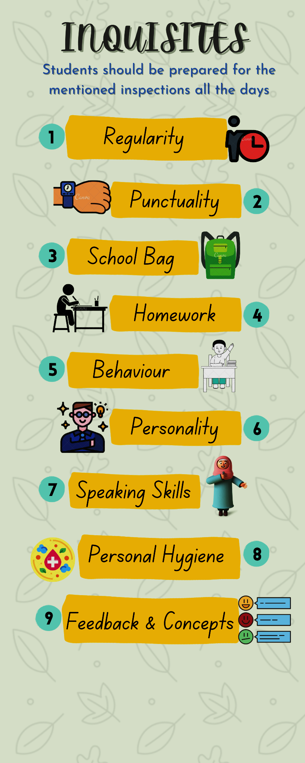
4

Slide 7

SCHOOL
RECOMMENDED BOOKS
CLASS- II
Sr. No. | Subject | Books
1 | ENGLISH | MY GREEN BOOK OF ENGLISH (English Press)
2 |  | GOOD WITH GRAMMAR (Neuberg)
3 | HINDI | हिन्दी पाठ्यपुस्तक -भाषा सेतु (प्राची )
4
 |  | सार्थक हिन्दी व्याकरण
5 | MATHEMATICS | MATHEMATICS FOUNDATIONAL STAGE (Amaira Books Private Limited)
6 | EVS | MY GREEN WORLD 2 (Millenium Books India Private Limited)
7 | GENERAL KNOWLEDGE | FUTURE KIDS BOOK OF G.K
8 | REASONING | REASONING APTITUDE WITH G.K
9 | COMPUTER | CYBER KIDS (COMPUTER)
10 | DRAWING | WINGS OF ART
5

Slide 8
FIRST TERM
MONTH/ SUBJECT | ENGLISH
Note | For enhancing reading and writing skill: Word Meaning, Dictation of difficult words, Sentence formation, Question- answers, Book exercise and complete the lines of the poem will be taken.
APRIL | Literature- L1 -No Smiles Today, Poem 3- Two Kites Grammar- U1 - Naming Words Or Nouns U2 - A Or An Reading Skills-Pg.no 17 Talking About a Hobby Writing Skills - Compositions - All About Me, Our Mother Earth Art Integration:Crafting a beautiful paper kite Experiential Learning:Passing the Parcel(Noun)
MAY | Literature- L 2- Grandma’s Spectacles,Poem 5 - Bumble Bee Grammar- U3 - One And Many (Singular/Plural) U4 - Pronouns ,Pg.no.99. Reading Skills- Pg.no. 24 Describing Family Time Writing Skills- Compositions - My Birthday Party, My Pet Art Integration:- Prepare your own crazy Spectacles. Experiential Learning: Fun with Plural Nouns (spelling rules poem)
JULY | Literature- L4- The Old Rabbit Grammar- U5 - Adjectives, U6- Let’s Compare Adjectives, Pg.no.94,95,96,97. Reading Skills- Panchtantra Stories Writing Skills- Compositions - Shopping with Papa, Visit to a Zoo Art Integration:- Draw a beautiful picture of a rabbit pasting your picture as its face. Experiential Learning: Adjectives (Describing your partner)
AUGUST | Literature- L7 -Little Grains of Wheat Grammar- U7 - Is,Am, Are,Was, Were U8 - Have, Has, Had, Pg.no.89,90,91. Reading Skills- Pg .no.56 Talking about your favourite food. Writing Skills- Compositions - Independence Day, Good Habits for Happy Kids,Pg.no 56 Art Integration:- Paste picture of various wheat products
SEPTEMBER | REVISION FOR FIRST TERM ASSESSMENT
6

Slide 9
महीना / विषय | हिंदी
नोट :- | सभी पाठों के कठिन शब्दों का श्रुतलेख, शब्दार्थ, प्रश्न-उत्तर, वाक्य रचना, कविता की पंक्तियाँ तथा पाठ के अभ्यास करवाए जायेंगे
अप्रैल | पाठ्यपुस्तक:- पाठ-2 घंटासुर, कविता- 1 सीखा है हमने व्याकरण- पाठ- 1 बातों वाली आवाजें (हमारी भाषा ) पाठ-2 वर्ण कई अपनी भाषा में ( वर्णमाला ) रचनात्मक लेखन- कक्षा का पहला दिन, जल ही जीवन है अतिरिक्त पठन- पृष्ठ संख्या -14,15,16 कला एकीकरण- पृष्ठ संख्या - 20 (दिए गए चित्र में रंग भरिये I) प्रस्तुतीकरण- कविता वाचन प्रायोगिक ज्ञान:- स्वरों का सुंदर पेड़ बनायें I
मई | पाठ्यपुस्तक:- पाठ- 3 आओ मिलकर पेड़ लगाएँ कविता- 5 किसने मेरा बाग सजाया व्याकरण- पाठ- 3 व्यंजन माँगे स्वर का साथ (मात्राएँ) पाठ- 4 वर्ण- वर्ण शब्द, शब्द-शब्द वाक्य (शब्द और वाक्य) रचनात्मक लेखन-मेरा प्रिय खिलौना- मेरी कार, मित्र का जन्मदिन अतिरिक्त पठन-पृष्ठ संख्या -21,22 कला एकीकरण-अलग अलग पेड़ों की पत्तियाँ चिपकाकर पेड़ों के नाम लिखें I प्रायोगिक ज्ञान:-पृष्ठ संख्या 26 (ज्ञान विस्तार)
जुलाई | पाठ्यपुस्तक:- पाठ- 4 साहसी अमित , पाठ-6 झाँसी की रानी व्याकरण- पाठ- 5 नाम ही है मेरी पहचान (संज्ञा) , पाठ- 6 शब्द ही होते लड़का लड़की (लिंग) रचनात्मक लेखन- मेरे सपनों का घर, व्यायाम - स्वास्थ्य की कुंजी अतिरिक्त पठन- वीरांगना रानी चेन्नमा (ज्ञान विस्तार ) कला एकीकरण- पृष्ठ संख्या-34आइसक्रीम स्टिक से फोटोफ्रेम बनायें I प्रस्तुतीकरण- संज्ञा गीत प्रायोगिक ज्ञान:-पृष्ठ संख्या 43 (खेल -खेल में )
अगस्त | पाठ्यपुस्तक:- पाठ- 7 पंद्रह अगस्त कविता- 9 पुनः नया निर्माण करो व्याकरण- पाठ- 7 एक अनेक शब्द (वचन) पाठ- 8 नाम वाले शब्द (सर्वनाम ) पाठ-15 चित्र-वर्णन रचनात्मक लेखन- शिक्षा का महत्व, रक्षाबंधन अतिरिक्त पठन- पृष्ठ संख्या -48 ,49 , 50 कला एकीकरण- भिंडी की सहायता से फूलों का चित्र बनायें I प्रस्तुतीकरण- रोल प्ले (स्वतंत्रता सेनानी ) प्रायोगिक ज्ञान:-अंतर खोजें
सितम्बर | अर्द्धवार्षिक परीक्षा के लिए दोहराई
7

Slide 10
MONTH/ SUBJECT | MATHS
APRIL | Unit-1 Numbers from 100 to 200 Unit-2-Numbers from 201 to 1000 , Tables - 2 to 5 Art Integration:- Make an Abacus by using smilies. Experiential Learning: Place value game (Learning with fun )
MAY | Unit- 3 Addition, Unit -7 Basic Geometry (Rectangle, Square) , Tables - 6 &7 Art Integration:- Properties of addition will be taken by using stars. Experiential Learning: Fun with shapes using clay modelling
JULY | Unit- 4 Subtraction, Unit-12 Patterns ,Tables- 8 & 9 Art Integration:- Properties of subtraction will be taken by using bindis. Experiential Learning: Build & Crash subtraction game
AUGUST | Unit- 5 Multiplication, Unit - 7 Basic Geometry(Triangle, Circle) , Table of 10 Art Integration:- Make a spacecraft by using different geometrical shapes. Experiential Learning:Multiplication board game
SEPTEMBER | REVISION FOR FIRST TERM ASSESSMENT
MONTH/ SUBJECT | EVS
APRIL | Ch-1 Body and Health, Ch-2 Inside My Body Art Integration:- Pg.no.12 (Make your body) Audio -Video Session:- My Body
MAY | Ch-3 Family and Friends, Ch-4 Houses We Live In, Ch-7 Places of Worship. Art Integration:- Craft a beautiful hut by using cl;ay and straw Audio -Video Session:-Houses we live in.
8

Slide 11

JULY | Ch-5 Food We Eat, Ch-8 Days to Celebrate, Ch-9 People Who Help Us Art Integration:- Make a plan of the various food items you would like to have for breakfast ,lunch & dinner for one day & paste it in your notebook. Audio-Video Session:- People who help us
AUGUST | Ch-10 Neighbourhood Services, Ch-18 Games We Play. Art Integration:- Make a colourful postcard and write your address on it . Audio-Video Session:-Games We Play
SEPTEMBER | REVISION FOR FIRST TERM ASSESSMENT
MONTH/ SUBJECT | GENERAL KNOWLEDGE & REASONING
APRIL | L-1 Vegetable Shop, L-9 Famous Folks L-15 Happy Celebrations L-21 A Long Time Ago, L-27 Safety Checks, L-36 Games I Play, GK Hunt-1 Current Affairs Reasoning: Unit 5 - Pattern
MAY | L-2 Animals Home, L-10 The Big and the Small, L-16 Clothes to Wear , L-43 Tick Tock Clock, L-22 Compound It L-28 See My Body ,GK Hunt-2 Current Affairs Reasoning: Unit 1 - Matching, Unit 2 - Sorting
JULY | L-3 Flowers For Mother, L-11 Which City, L-29 Airy Airy, L-17 City Names L-23 The Hare and The Tortoise L-37 Animal Yoga, GK Hunt-3 Current Affairs Reasoning: Unit 3 - Classification
AUGUST | L-4 Plant in a Test, L-12 Flags are Fun, L-18 Great Indians, L-43 Racing Track L-24 Fairy Land ,L-30 Fibre to Fabric,L-38 Fun to Play, GK Hunt-4 Reasoning: Unit 8 - Quantitative Quiz
SEPTEMBER | REVISION FOR FIRST TERM ASSESSMENT
9

Slide 12

MONTH/ SUBJECT | ICT
APRIL | Ch - 1 Know Your Computer Lab Activity: Divide the class into two groups, name the first Group as’ Humans’ and Second ‘Computer’. Student will speak on What Humans can do but Computer cannot and Vice-Versa. Programming: 1) Introduction to Scratch Jr. , how to choose a character, remove a character, Select a background. 2) Make a beautiful Scenery.
MAY | Ch - 2 Uses of Computer Lab Activity: Find the uses of computer. Programming: 1) Motion block 2) Add two characters of your choice and make one to move 10 steps left and other 10 steps right.
JULY | Ch - 3 Knowing Computer Parts Ch - 4 How does Computer Work Lab Activity: 1) Make a list of main parts of computer. 2) With the help of real-life examples student will explain the concept of I-P-O cycle. Programming: 1) Hop, Go Home/Reset command, turn clockwise and anti-clockwise. 2) Select the character earth and backdrop, rotate towards right 10 steps.
AUGUST | Ch - 5 Exploring the keyboard Lab Activity: With the help of keyboard type any five sentences on ‘My Family’. Programming: Speech bubble, hide/seek command 1) Select a character and make the character say five things about ‘You’. 2) Select a monkey character and make it hop 10 times.
SEPTEMBER | REVISION FOR FIRST TERM ASSESSMENT
10

Slide 13
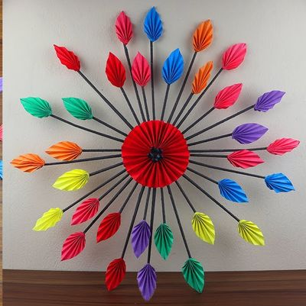
MONTH/ SUBJECT | ART & CRAFT
APRIL | Topic-Front page , Clouds and trees Book page no.- 3,4,5 Activity: Earth Day Activity
MAY | Topic- Summer Scene , Tortorise Book page no.- 6,7,8,10 Activity: Mother’s Day Activity
JULY | Topic-Vegetable Composition, Flower and a butterfly Book page no.- 13,15,16 Activity: Monsoon Activity
AUGUST | Topic- Warli Art , Mud House Book page no.- 14,9,24 Activity: Rakhi Making ,Janmashtami Activity
Art is the souls expression,
And craft is the hands devotion-
Together they create magic.
11

Slide 14
SECOND TERM
MONTH/ SUBJECT | ENGLISH
OCTOBER | Literature- L6 - A Lesson Learnt Poem- Little Birdie Grammar- U9- Simple Present Tense, U10– Present Continuous Tense Reading Skills-Pg.no.46 (Pronouns) Writing Skills- Compositions - Every little Drop counts, My Happy Classroom. Experiential Learning: Role play of the Story Art Integration: Draw a beautiful picture of a birdie
NOVEMBER | Literature- L8- A Naughty Monkey Poem- To Bed Grammar- U11 Simple Past Tense -U12 Past Continuous Tense Reading Skills-Pg.no.89( About the poet) Writing Skills- Compositions - My Superhero Friend, The Colours of Nature, Unseen Passage Art Integration: Draw an adjective chart of a monkey
DECEMBER | Literature- L10- Oh, Trash ! Grammar- U13 -Adverb, U14-Preposition – U15 Joining Words Reading Skills- Unseen Passage Writing Skills- Compositions - Books Treasure of Knowledge, My First Piggy Bank Art Integration:- Colouring Activity (Pg.no.76),Draw picture of different types of trash bins. Experiential Learning: Cleanliness Drive in school.
JANUARY | Literature- L11 - Dosa and His Four Friends Grammar- U16- Possessives, U17 -The Sentence, U18- The Comma and Apostrophe Reading Skills- Unseen Passage Writing Skills- Compositions - Snowy Winter Season, Planting the Magic Seeds Art Integration:- Draw a south India food platter in your notebook. Experiential Learning: Project work Pg.no.86 (Be Clean, Be Healthy)
FEBRUARY | REVISION FOR FINAL TERM ASSESSMENT
12

Slide 15
महीना / विषय | हिंदी
अक्टूबर | पाठ्यपुस्तक:- पाठ- 8 आइजक न्यूटन पाठ-10 पानी रे पानी व्याकरण- पाठ-9 सबके गुण बतलाते हम (विशेषण) , पाठ-10 काम करने वाले शब्द (क्रिया) रचनात्मक लेखन- एक कदम स्वच्छता की ओर, दीपावली अतिरिक्त पठन- पृष्ठ संख्या - 70 अब समझ आया ! कला एकीकरण- जल चक्र का चित्र बनायें I प्रस्तुतीकरण- विशेषण शब्दों से कविता बनाकर कक्षा में सुनाएं l
नवम्बर | पाठ्यपुस्तक:- पाठ- 11 भारत दर्शन पार्क , पाठ- 13 ताजमहल कविता- 12 फूल हमेशा मुस्काता व्याकरण- पाठ-11 हम सबका है मतलब एक (पर्यायवाची या समानार्थी शब्द) पाठ-12 किसी शब्द का उल्टा हम ( विलोम शब्द ) रचनात्मक लेखन- बाल दिवस, पेड़ हमारे मित्र अतिरिक्त पठन- पृष्ठ संख्या - 74 ,75 कला एकीकरण- खाली बोतल से सुंदर सा फ्लावर पॉट बनाइये l प्रस्तुतीकरण- पृष्ठ संख्या - 81 (व्याकरण ) खेल-खेल में प्रायोगिक ज्ञान:- बेकार चीज़ों से एक गुड़िया बनाइये l
दिसम्बर | पाठ्यपुस्तक:- पाठ- 14 पक्षी और व्हेल कविता- 15 कोयल व्याकरण- पाठ- 13 अब गिनने की बारी (गिनती) पाठ- 14 हमारा कैलेंडर (दिन और महीने) रचनात्मक लेखन- मैंने अपनी छुट्टी कैसे बिताई, मेरा प्रिय खेल – कबड्डी अतिरिक्त पठन- पृष्ठ संख्या - 94,95,96 कला एकीकरण- जलीय जीवों के चित्र बनाकर उनके नाम लिखिए l प्रायोगिक ज्ञान:-पशु पक्षियों से सम्बंधित एक कहानी कक्षा में सुनाइये I
जनवरी | पाठ्यपुस्तक:- पाठ- 16 हमारा तिरंगा झंडा कविता- 17 वर्षा ऋतु आई व्याकरण- पाठ- 15 नन्ही कलम (वस्तु वर्णन) , पाठ-16 कविता कहानी लेखन ( कविता-कहानी) , बोलने की बारी (मौखिक अभिव्यक्ति) ,हमारा अपना शब्द भंडार (शब्द अर्थ) रचनात्मक लेखन- मेरी पतंग, ऋतुओं का राजा - बसंत ऋतु अतिरिक्त पठन- पृष्ठ संख्या - 107,108 कला एकीकरण- अभ्यास पुस्तिका में तिरंगा झंडा बनाकर उसमे रंग भरिए l
फ़रवरी | वार्षिक परीक्षा के लिए दोहराई
13

Slide 16
MONTH/ SUBJECT | MATHS
OCTOBER | Unit- 6 Division, Unit-11 Data Handling, Table of 11 &12 Art Integration:- Make a division flower in your notebook Experiential Learning: Number Crash Division Game
NOVEMBER | Unit-10 Measurement, Unit-7 Basic Geometry (Cone, Sphere) Table of 13&14 Art Integration:- Cut & Paste pictures of cone & spherical objects. Experiential Learning: Presentation of various types of measurement using different measuring tools.
DECEMBER | Unit- 9 Money, Unit-7 Basic Geometry(Cylinder), Table of 15 Art Integration:- Paste dummy notes & coins in your notebook. Experiential Learning: Shopping Games (Role Play between Shopkeeper & customer)
JANUARY | Unit- 8Time, Unit-7 Basic Geometry(Cube, Cuboid) Art Integration:- Design your own clock & paste it in your notebook. Experiential Learning:Reading Times Throughout the day.
FEBRUARY | REVISION FOR FINAL TERM ASSESSMENT
MONTH/ SUBJECT | EVS
OCTOBER | Ch-11 Map of India, Ch-12 Plants And Animals around Us Art Integration:- Draw different trypes of leaves you see around. Experiential Learning: Nature Walk/ Nursery visit
NOVEMBER | Ch-13 Weather and Seasons , Ch-14 Earth and its Neighbours Art Integration:- Make a collage of different seasons. Audio-Video Session:- Weather & Seasons
DECEMBER | Ch- 16 Means of Communication, Ch-17 Transport and Safety. Art Integration:- Draw the scene showing all three modes of transport Audio-Video Session:- Traffic Safety Rules
JANUARY | Ch-6 Clothes We Wear, Ch-15 Save the Earth Art Integration:- Paste pictures of diffent types of fabric and make a poster on SAVE THE EARTH.
FEBRUARY | REVISION FOR FINAL TERM ASSESSMENT
14

Slide 17
MONTH/ SUBJECT | GENERAL KNOWLEDGE & REASONING
OCTOBER | L- 17 City Names, L - 20 Our National Symbols, L – 21 A Long Time Ago! , L-34 Recycling, L-37 Animal Yoga , L-47 Cheeky Cartoons, GK Hunt-5 Reasoning: Unit 7 - Tiles
NOVEMBER | L- 23 The Hare and The Tortoise , L-30 Fibre to Fabric, L-36 Games I Play, L-39 Sports Personalities, L-42 Tick Tock Clock , L-48 Birthday Party ,GK Hunt-6 Reasoning: Unit 4 - Ordering
DECEMBER | L-24 Fairy land, L-28 See My Body, L-31 Gadgets Guess, L-40 My Sports Equipment’s , L-44 My Bookmark, L-46 Number Champion, GK Hunt-7 Reasoning: Unit 10 - Aptitude Test
JANUARY | L- 9 Famous Folks, L-11 Which City?, L-14 Spotlight on Africa, L-19 Nicknames, L-25 Riddle My Friends, L-38 Fun To Play , GK Hunt-8
FEBRUARY | REVISION FOR FINAL TERM ASSESSMENT
MONTH/ SUBJECT | ICT
OCTOBER | Ch - 6 Using the Mouse, Ch -7 Operating Windows Lab Activity: Students will create an Animal Race Game in Scratch Jr. by using on tap block, set speed block.
NOVEMBER | Ch - 8 Storing your data, Ch - 9 Draw and Paint Lab Activity: 1) Make the list of the devices used to store our data. 2) Draw a colorful computer (using shape tool). Programming: 1) Sound block, start on bump block 2) Girl character collecting flower.
DECEMBER | Ch - 10 Fun with Tux Paint Lab Activity: Draw a winter scene and color it. Programming: 1) Background change. 2) Catch the apples in bowl with touching line.
JANUARY | Ch - 11 Typing Using WordPad Lab Activity: Type a poem in word pad window and save it. Programming: 1) Event block. 2) Make the bus character to move continuously 50 till we press red button to Stop.
JANUARY | REVISION FOR FINAL TERM ASSESSMENT
15

Slide 18

MONTH/ SUBJECT | ART & CRAFT
OCTOBER | Topic- Stippling Art, Camera with shapes Book page no.- 26,28,29 Activity: Dusshera Activity
NOVEMBER | Topic-Peacock, Tulip Book page no.- 30-32 Activity: Paper Tulip Flower
DECEMBER | Topic-Penguin, Sail Boat Book page no.- 34,35,36 Activity: Christmas craft
JANUARY | Topic-Cartoon Character, Mushroom Book page no.- 39,40 Activity: Republic Day Activity
16

Slide 19
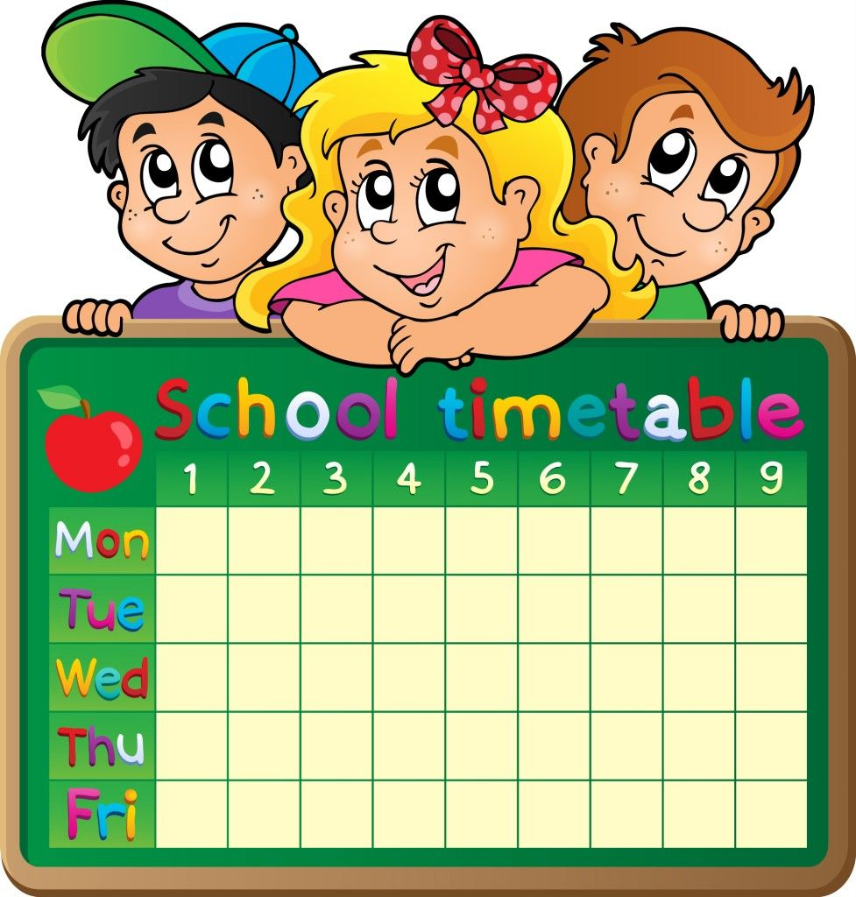



English Reader | First 20 days of the month
English Grammar | First 10 days of the month
Hindi Reader | First 20 days of the month
Hindi Grammar | First 10 days of the month
Maths | Monday to Saturday
E.V.S. | Monday to Thursday
G.K.,Reasoning & Composition book | Friday and Saturday
Notebooks
English | 2 Notebooks (Four lines)
Hindi | 2 Notebooks (Five lines)
Maths | 2 Notebooks (C.W + H.W.)
E.V.S. | 1 Notebooks (Four lines)
G.K. | 2 Notebooks (Four lines)
17

Slide 20
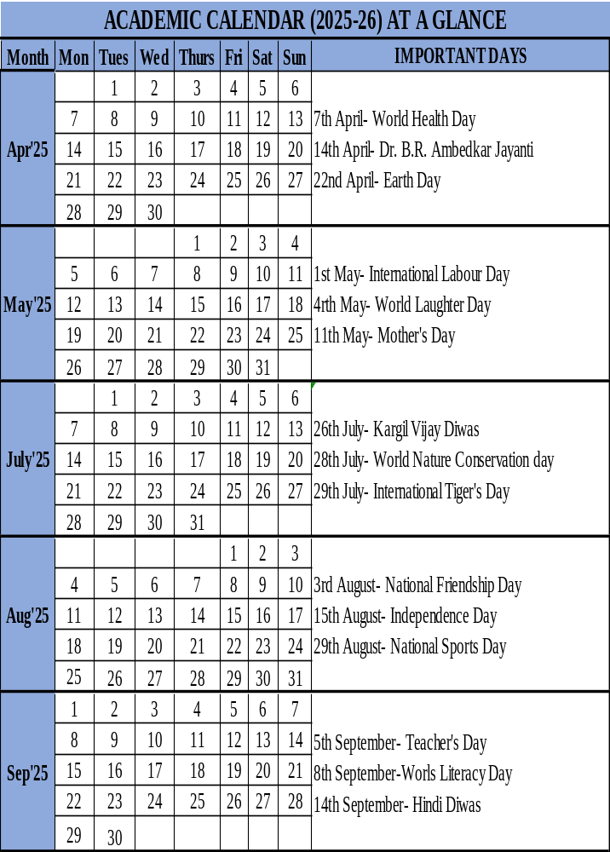
18

Slide 21
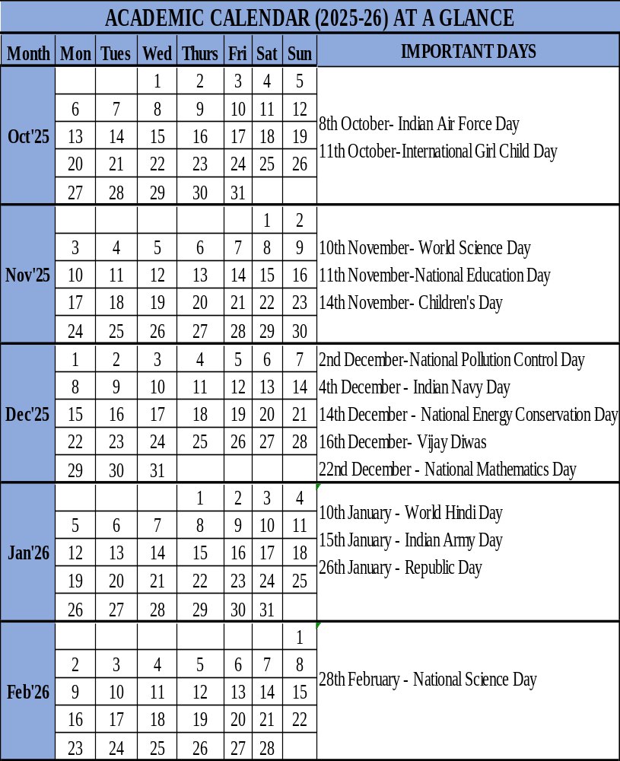

19

Slide 22

ACADEMIC CALENDAR OF THE SCHOOL
CO SCHOLASTIC ACTIVITIES (Classes : I - II )
Month/ Class | I | II
April | Plantation Drive | Nature Walk
May | Mother’s Day Crown | Mother’s Day Crown
July | Health Awareness | Its Show Time- Ad Enactment
August | Independence Day Veer Gatha | Independence Day Veer Gatha
September | Hindi Diwas | Celebrating Indian Litreature
October | Udaan – The Annual Fest Cleanliness Drive | Udaan – The Annual Fest Cleanliness Drive
November | Annual Sports Day (JW) Diwali Celebration | Annual Sports Day (JW) Diwali Celebration
December | Safety Week Christmas Celebration | Safety Week Christmas Celebration
January | Unity in Diversity | Unity in Diversity
20

Slide 23
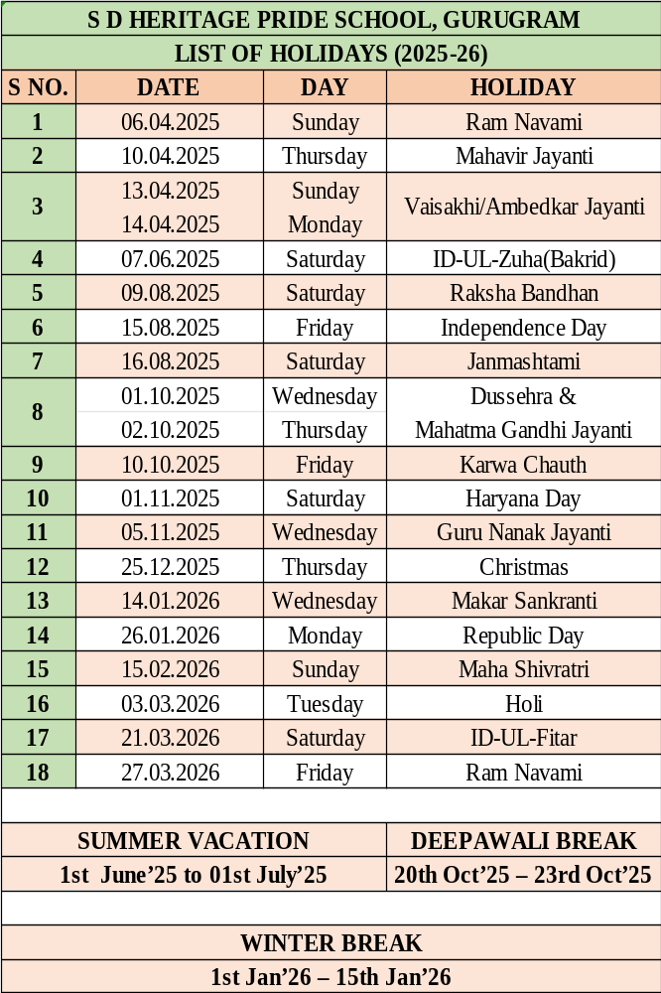

21

Slide 24

"Education embraces the uniqueness of every child, nurturing their strengths, passions, and dreams. It shapes not just their minds but also their hearts, inspiring a lifelong love for learning and a meaningful purpose in life."

